Slide 1
Discretely innovating:
Barriers to entry, contestability and innovation
Steven Bond-Smith
Bankwest Curtin Economics Centre
Curtin University, Perth, Australia
steven.bond-smith@curtin.edu.au
AEA/ASSA Annual Meeting, Chicago, IL
8 January 2017

Slide 2
Background
What is the relationship between barriers to entry and innovation?
It is logical that barriers to entry hinder innovation:
  But what are the nuances of this relationship?
  And what are the effects?
The importance of market structure to innovation
  Market liberalisation – Assumes that contestability and competition drive prosperity
  Increasing inequality – barriers to entry could drive inequality
  What if liberalised markets are not entirely “contestable”?

Slide 3
Background
Related literature
Competition is an inverted-U relationship (Aghion et al., 2005)
  Technology race, distance to frontier models (Acemoglu et al., 2006; Aghion et al., 2009)
  Escape entry, escape competition effects
  Schumpeter (profits attract innovative monopolist) vs
  Arrow (monopolists innovating hurt their own profitability)
But empirical literature emphasises technological opportunity (Scherer, 1967; Levin et al., 1985)

Slide 4
Drivers of contestability
Economies of scale
  Minimum viable scale
Regulatory requirements
Trade
Barriers to entry
What happens when markets are not contestable?

Slide 5
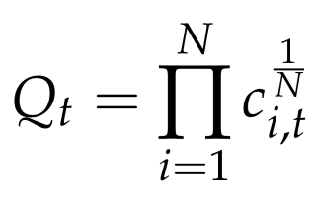
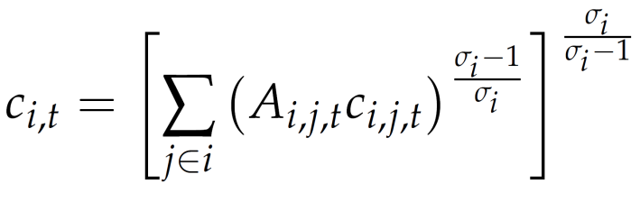
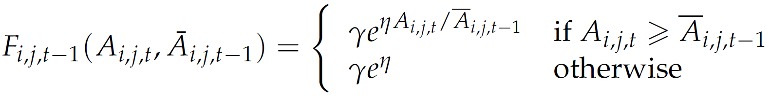
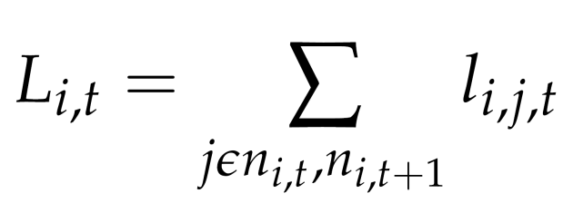
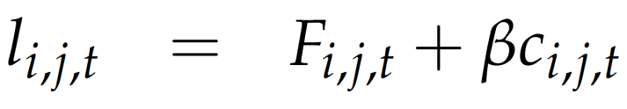
Model specification
Utililty – Many sectors, C-D & CES functions, quality
Innovation – Growth without scale effects or inverse scale assumptions
Specialised labour supply

Slide 6
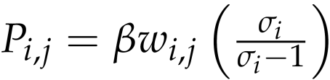
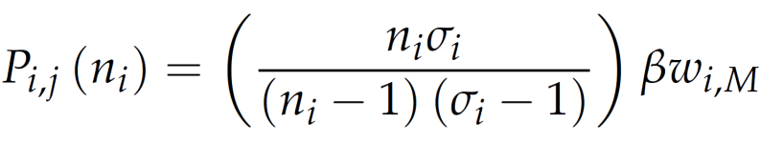
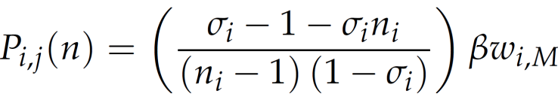
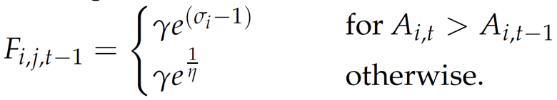
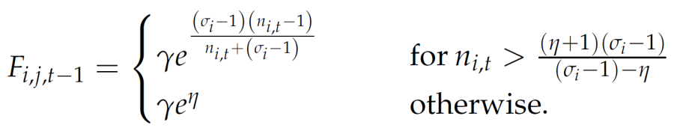
Model specification
Prices
Cournot Bertrand
Innovation
Cournot Bertrand

Slide 7
Implications for growth
Specialised factor of production required in fixed cost of entry represents the structural barrier to entry.
This factor attracts a premium
  E.g. taxi licences, real estate locations or other factor.
Resource base and entry cost pin down discrete number of entrants.
“Lucky” workers attract entrepreneurial premium.
Manufacturing wage declines to clear the market – Entry barriers may drive inequality.

Slide 8
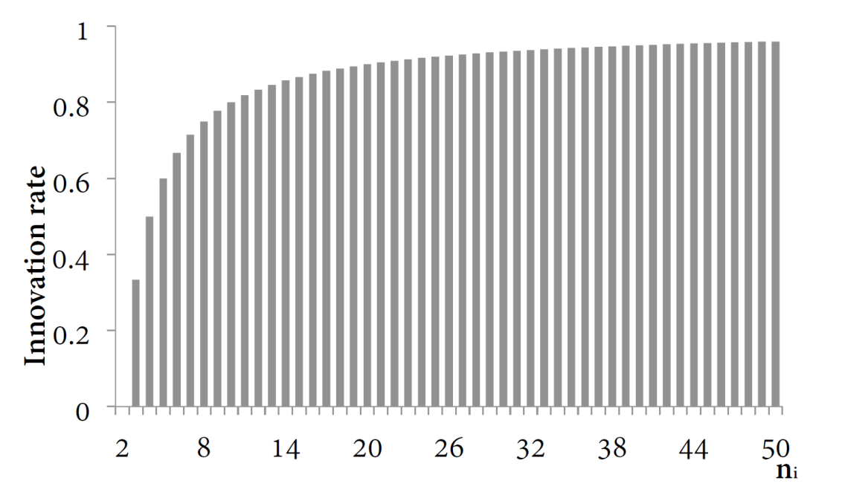
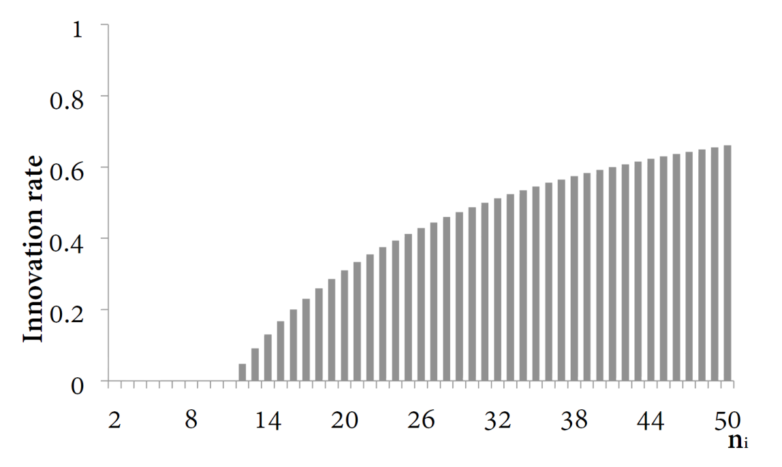
Implications for growth
Bertrand
Cournot

Slide 9
Bertrand vs Cournot innovation
What is the impact of different forms of competition?
Background
Cournot provides larger profits
  Attractive for innovation investment
When contestable & continuous, Cournot = Bertrand
  All profits are used for innovation with free entry
Barriers
When not contestable, Cournot innovation < Bertrand innovation
  Cournot firms withhold innovation to retain profit allowing more entry
  Bertrand firms invest more – but fewer firms enter.

Slide 10
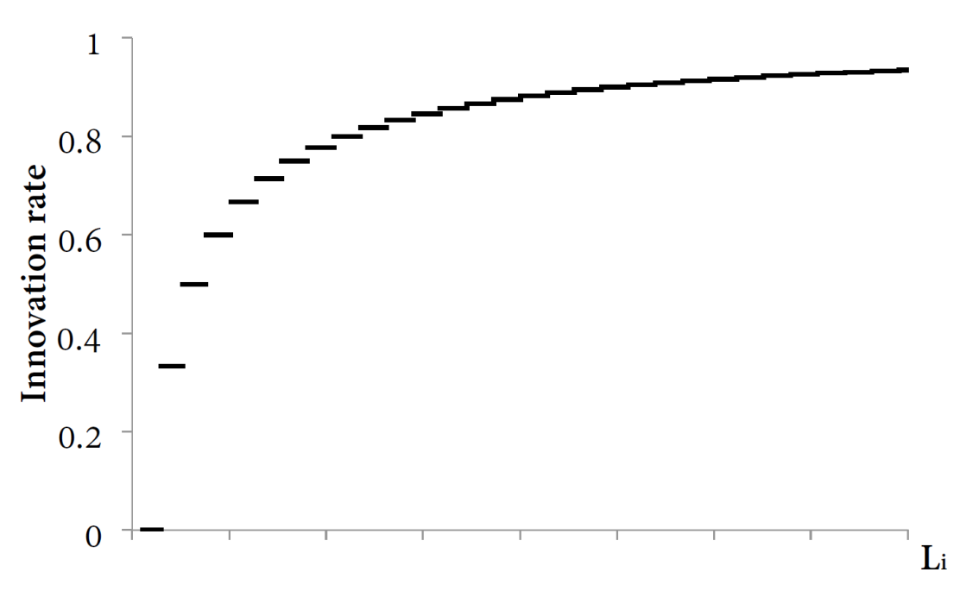
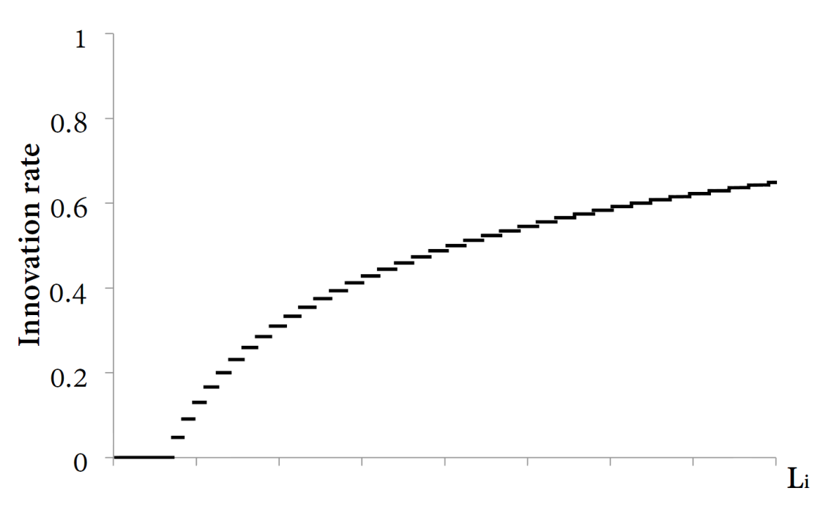
Bertrand vs Cournot innovation
Cournot firms withhold more profit, allowing more entry for the same resource constraint
Bertrand
Cournot

Slide 11
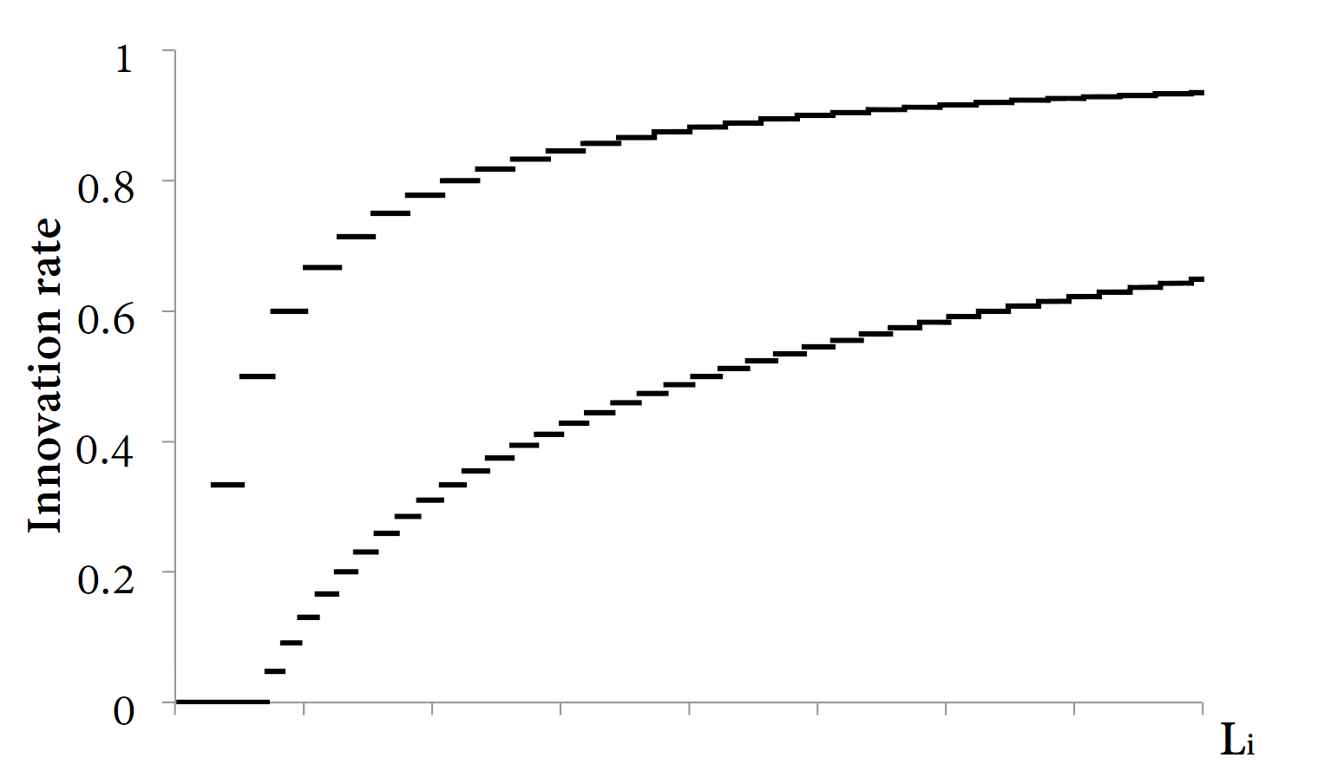
Bertrand vs Cournot innovation

Slide 12
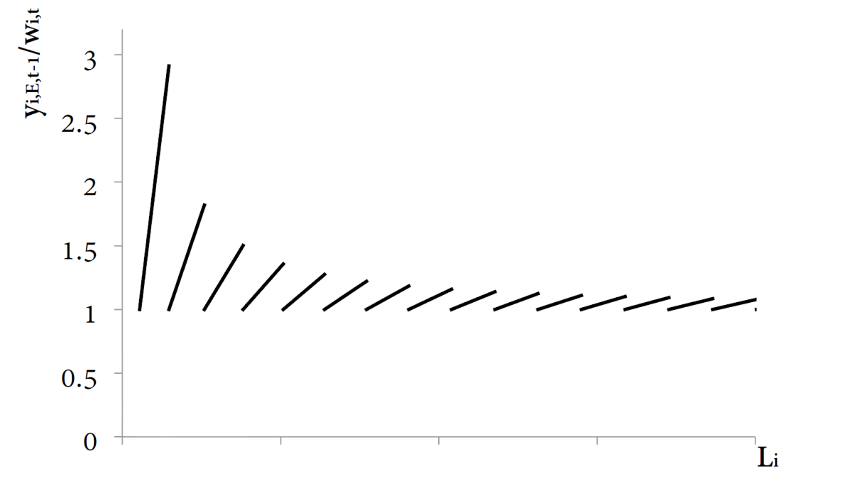
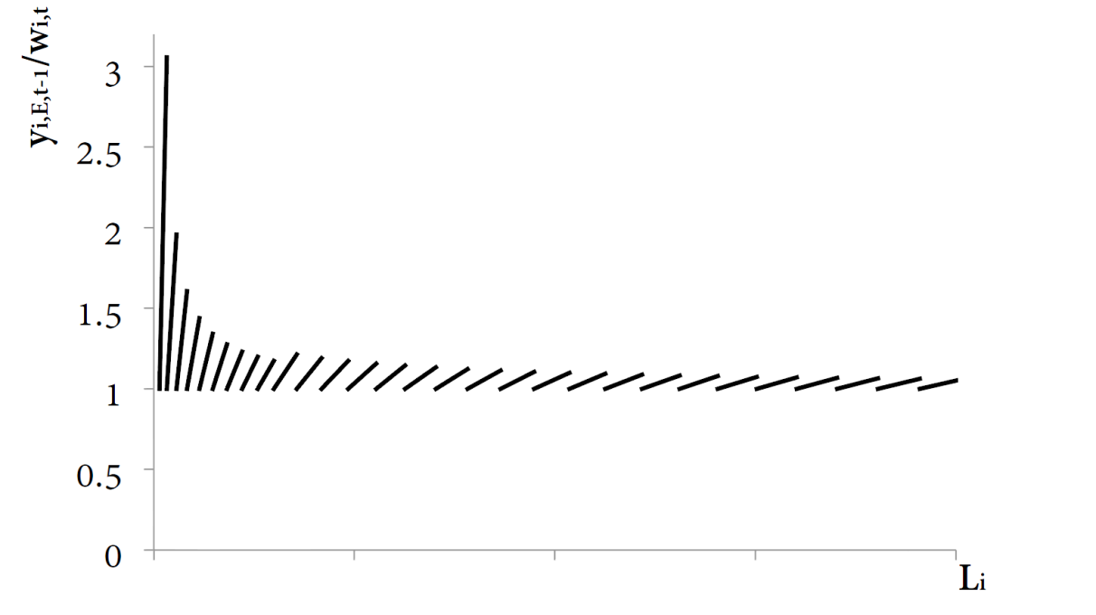
Barriers to entry and inequality
Wage inequality is dependent upon the extent that the marginal firm is prevented from entering by the limited supply of specialised labour.
Bertrand
Cournot

Slide 13
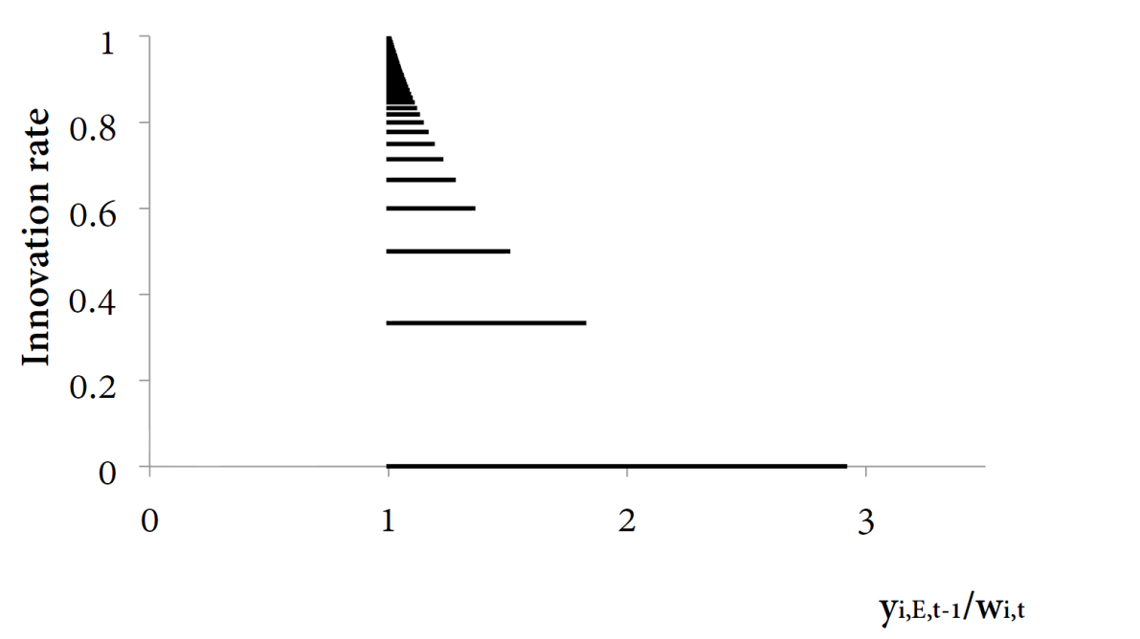
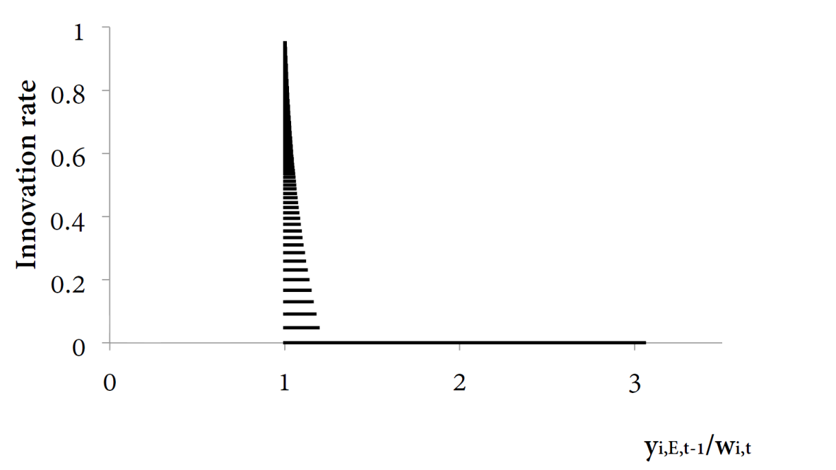
Innovation and inequality
Bertrand
Cournot

Slide 14
Policy implications
Intuitive response – examine factors affecting the cost of innovation – “weak form” policies
  Expand factor of production, R&D infrastructure or other requirements for entry
  Does not address discrete entry barrier.
Break discrete nature of entry – “strong form” policies
  Allow smaller firms, foreign entry
  Remove license requirements, trade barriers or other minimum scale requirements
  For example, telecommunications or electricity
    Ladder of investment approach (Cave, 2006) regulating access to unbundled services
    Structural separation allows contestability for some elements without network requirements.

Slide 15
Concluding remarks
Contestability is a key driver of competition/innovation/growth results
Market liberalisation needs to ensure liberalised markets are contestable
  Ladder of investment
Implications for small markets:
  Equilibrium may have fewer firms leading to lower innovation and growth
Not every market will have these types of barriers to entry
  Non-tradeable sectors
  Economies of scale

Slide 16
References
Acemoglu, D., Aghion, P., & Zilibotti, F. (2006). Distance to frontier, selection, and economic growth. Journal of the European Economic Association, 4(1), 37–74.
Aghion, P., Bloom, N., Blundell, R., Grith, R., & Howitt, P. (2005). Competition and innovation: An inverted-u relationship. The Quarterly Journal of Economics, 120(2), 701728.
Aghion, P., Blundell, R., Griffith, R., Howitt, P., & Prantl, S. (2009). The effects of entry on incumbent innovation and productivity. The Review of Economics and Statistics, 91(1), 20–32.
Arrow, K. (1962). Economic welfare and the allocation of resources for inventions. In R. Nelson (Ed.), The rate and direction of inventive activity. Princeton University Press.
Cave, M. (2006). Encouraging infrastructure competition via the ladder of investment. Telecommunications Policy, 30(3-4), 223–237.
Levin, R. C., Cohen, W. M., & Mowery, D. C. (1985). R & d appropriability, opportunity, and market structure: New evidence on some Schumpeterian hypotheses. The American Economic Review, 75(2), 20–24.
Scherer, F. M. (1967). Market structure and the employment of scientists and engineers. The American Economic Review, 57(3), 524–531.
Schumpeter, J. (1942). Capitalism, Socialism and Democracy. New York: Harper and Brothers.

