Slide 1
Valuing ‘Free’ Media in GDP:
An Experimental Approach
Leonard Nakamura, Jon Samuels
and Rachel Soloveichik

Slide 2
Introduction
‘Free’ media like Google or broadcast television are economic products– but they don’t show up as final expenditures in GDP.
  Some researchers believe that ‘free’ media is worth $2 trillion (Brynjolfsson and Oh 2012).
Most ‘free’ media is supported by advertising.
  We tweak the GDP formula to count advertising-supported consumer entertainment in final output.
  Based on advertising expenditures, we estimate ‘free’ media only added $86 billion to GDP in 2012.
  We’re currently studying marketing-supported information like MLB.com. We estimate ‘free’ information added another $106 billion in 2012.

Slide 3
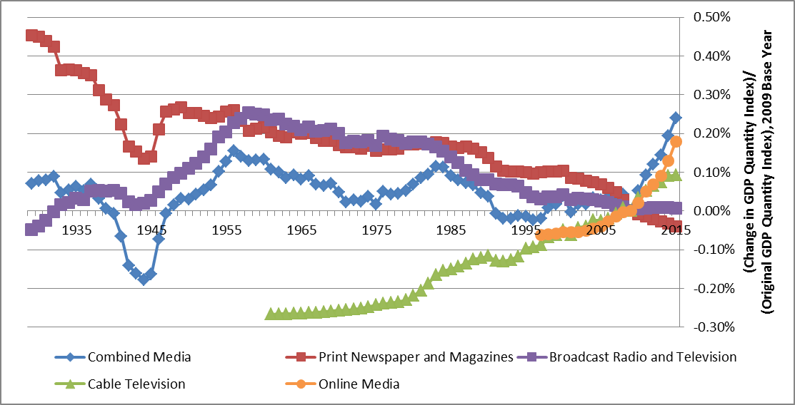
Preview of Results: Revisions to real GDP
‘Free’ online media has been growing rapidly, but it’s still relatively small.
Our experimental methodology doesn’t change overall GDP growth much.

Slide 4
Outline of Talk
Review the Standard GDP and Productivity Formulas.
Introduce an Experimental GDP Formula Which Includes Advertising-Supported Media in Final Expenditures.
Calculate nominal GDP and prices 1929 -2015.
  We also recalculate TFP by industry.
Discuss Silicon Valley’s Business Model of Ubiquity now, Revenue Later (URL).

Slide 5
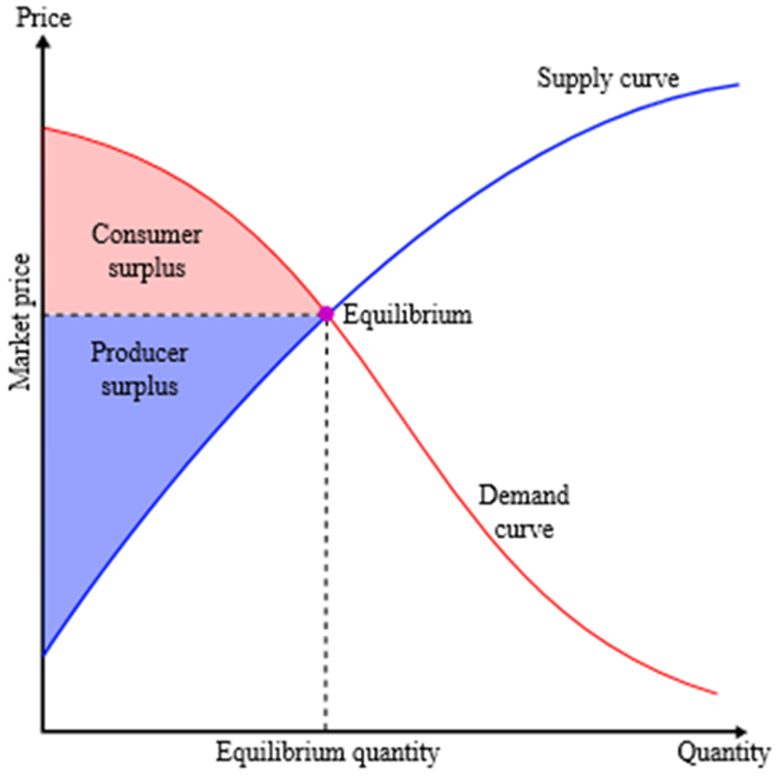
Measuring GDP in Period 0
The rectangle with the dotted lines has an area q₀p₀. It shows actual spending.
Measured GDP is q₀p_{0.}
The red triangle above shows consumer surplus. In other words, how much value does product q give?
For ‘free’ media, q₀p₀ is zero. So, it doesn’t add to measured GDP.

Slide 6
GDP Change from Period 0 to Period 1
The rectangle with the filled lines has an area q1p1. It shows actual spending now.
The change to nominal GDP is ambiguous. It depends whether q1p1 is bigger or smaller than q0p0.
Real GDP unambiguously increases by (q1/q0).
Consumer surplus unambiguously increases. The increase is between: (p0-p1)*q0 and (p0-p1)*q1.
These formulas don’t work well when either p0, p1, q0 or q1 are 0.

Slide 7
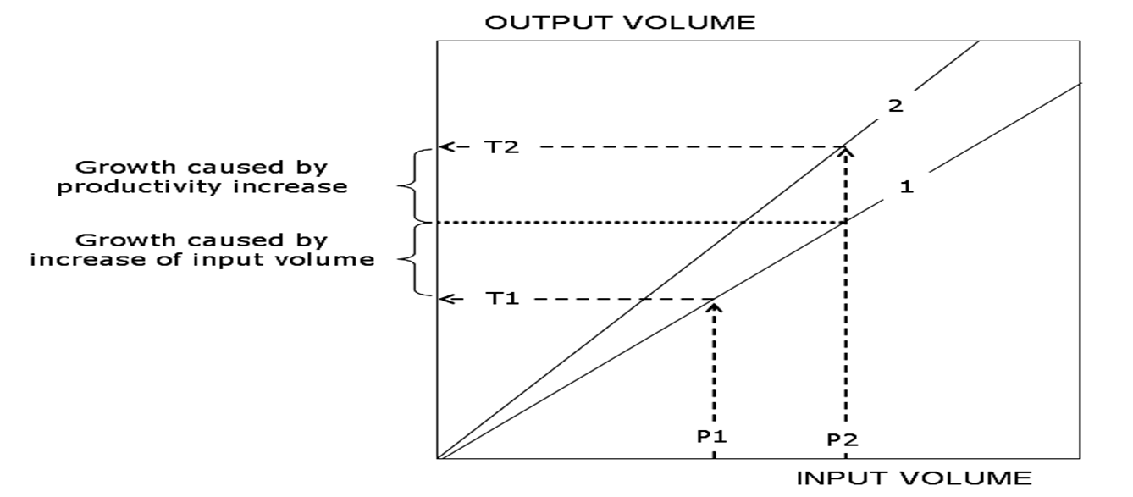
Measuring Productivity
When all inputs are completely fixed, productivity growth is easy to measure.
When inputs change over time, it’s very hard to disentangle input quantity changes from technology changes
  The standard productivity formula assumes constant returns to scale, smooth production functions, and competitive industries with profit-maximizing firms

Slide 8
Current Treatment of ‘Free’ Media
In BEA’s GDP statistics, sold products and services are the only output tracked.
  ‘Free’ media purchased from outside companies is tracked as an intermediate input.
  ‘Free’ media produced in-house isn’t tracked at all.
Both Google and television soap operas are positive externalities from ad slot production.
  Conceptually, this is similar to the treatment of negative externalities like pollution.

Slide 9
Our Experimental Treatment
The advertising and user engage in barter: the user watches ads in exchange for media.
  Income from watching ads is exactly equal to the value of media used.
When consumers use ‘free’ media, we treat it as final expenditures.
When businesses use ‘free’ media, treat it as an intermediate.

Slide 10
Historical Research on ‘Free’ Media
Borden (1935) was an early exploration of the proportion of advertising devoted to subsidizing content provision
Extensive discussion of ‘free’ media in GDP during the 1970s
  Ruggles and Ruggles (1970), Okun (1971), Jaszi (1971), Eisner (1978). Kendrick (1979)
Cremeans (1980) proposed a barter mechanism for measuring free media similar to the one we propose and estimated it
Vanoli (2000) discussed it in a history of national accounting
Nakamura (2005) modeled consumption gains in an expenditure model
Soloveichik (2014) revived this approach for US GDP
Soloveichik and Nakamura (2015) calculated ‘free’ media across countries.

Slide 11
Data Used to Track Advertising
We split advertising into: a) print newspaper or magazines ; b) broadcast radio or television; c) cable, satellite and other subscription video; d) online media.
  Each category has its time series of nominal expenditures, media prices and advertising viewership prices.
Our primary source is the 2007 Economic Census
  The Economic Census reports advertising by media category and industry.
  We include all advertising revenue, regardless of whether consumers pay zero out-of-pocket or a subsidized price.
  Our annual data is taken from the Service Annual Survey, the CS Ad expenditure dataset and other sources.

Slide 12
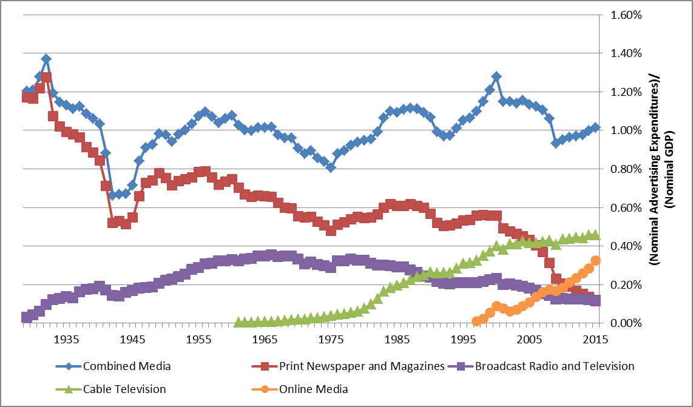
Nominal Advertising Expenditures
The explosion in online media is balanced out by drop in print media.
Consumers have also substituted from broadcast television to cable television

Slide 13
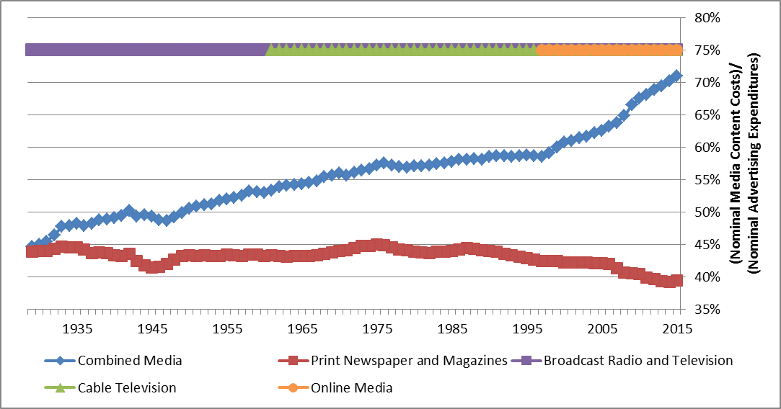
Expenditure Share for Media Content
(Media Content Costs) = (Total Advertising Revenue) – (Ad-Related Costs)

Slide 14
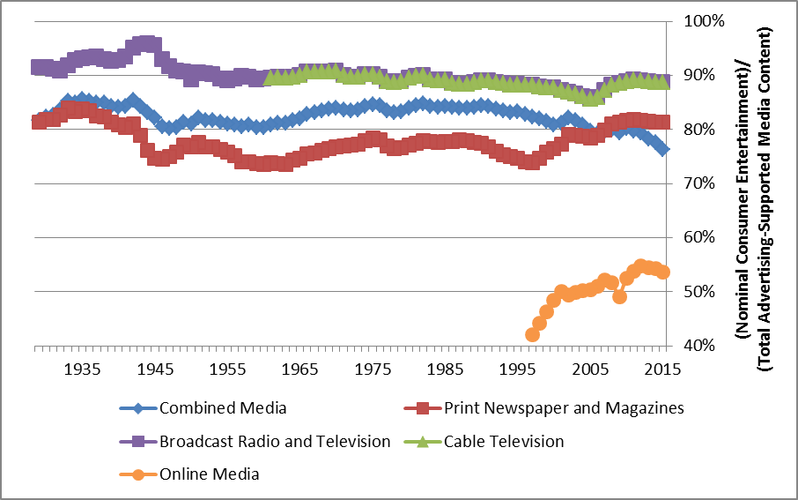
Consumer Share for Media
For online media, we use survey data to split personal and work Internet use
For other media categories, we use the Economic Census and our best judgement.

Slide 15
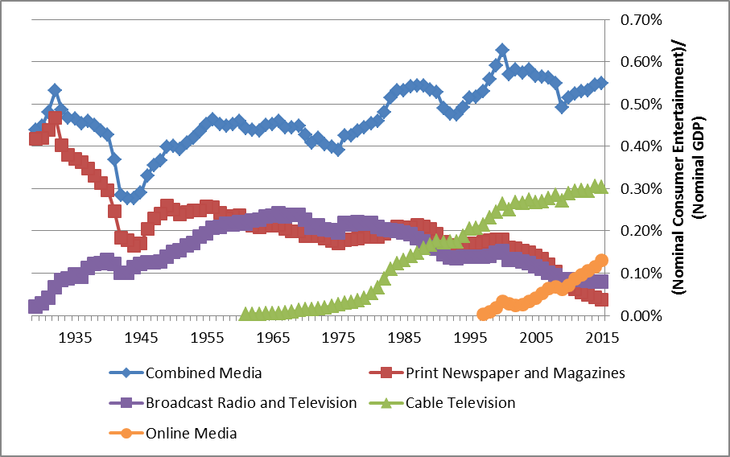
Nominal ‘Free’ Consumer Entertainment
Advertising-supported consumer entertainment has hovered around 0.5% of nominal GDP back to 1929 – so measured GDP growth doesn’t change much.

Slide 16
Prices for Ad-Supported Media Are Hard
Quality is extremely difficult to measure
  The media experience depends on not only the media program, but also consumer inputs like smartphones.
  Consumer preferences differ across people and over time.
Our price indexes are mostly based on BEA’s pre-existing price indexes for inputs to media production and output prices for similar goods.
  These price indexes do not account for network effects or other quality change.

Slide 17
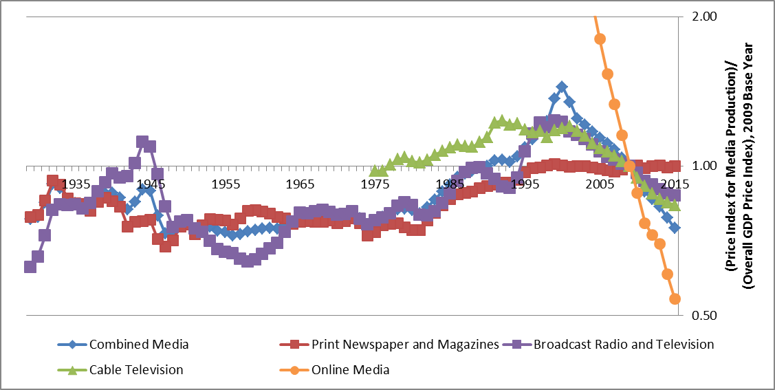
Prices for ‘Free’ Media vs. GDP Prices
Online media uses a lot of computers, so its production costs have dropped.
Cable television also uses computers to film programs and then transmit them.
In contrast, print media and broadcast media use less computers in production.

Slide 18
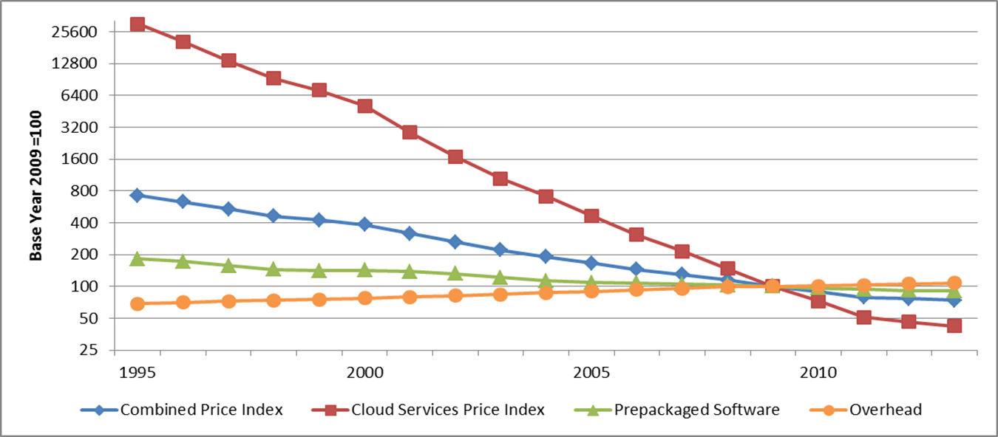
Prices for Online Media
Software is the main input, so online media prices track software prices closely.
  Internet companies also require servers to run their software and a few workers to deal with overhead.
Programmers have gotten much more productive at writing pre-packaged software and running server farms to provide cloud computing.
  As an upper bound on prices, we assume the same productivity growth for Internet software programmers.
These price indexes don’t take into account network effects and

Slide 19
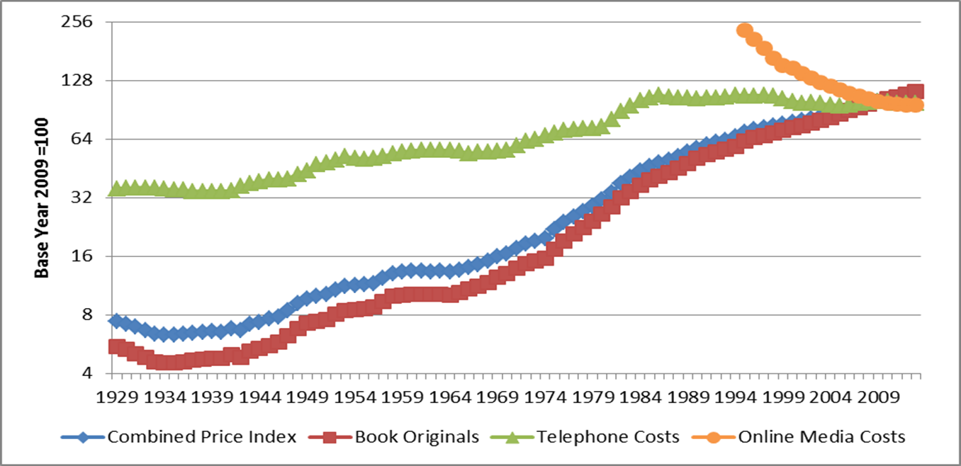
Prices for Print Media
We use book prices a proxy for newspaper writing costs.
  Newspapers (typically) require more outside research than books, so we include telephone service and online media costs in our index.

Slide 20
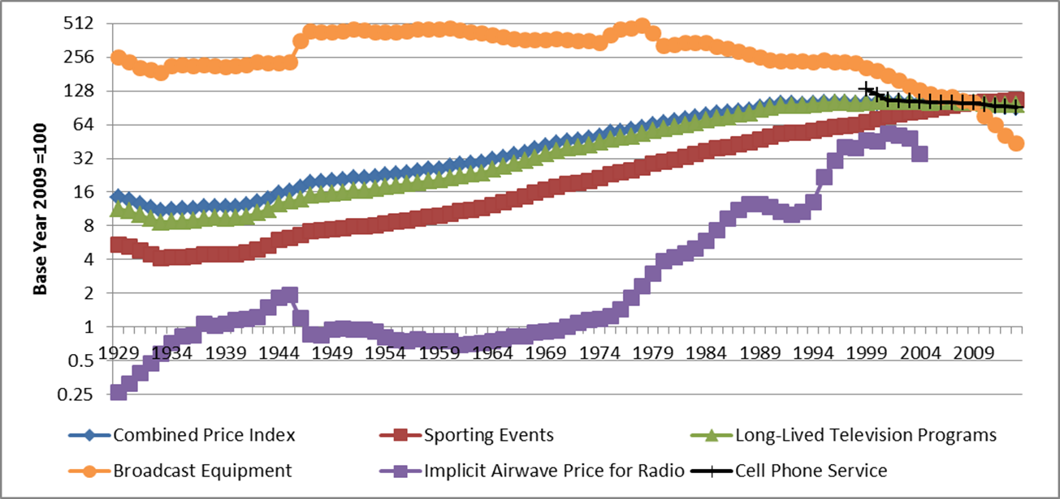
Prices for Broadcast Radio and Television
This price index is preliminary. For now, we calculate an implicit price index for the airwaves based on radio station sale prices reported by Duncan (2004)
  Duncan’s data only covers 1975-2004. Before 1975, we use nominal revenue per station as a proxy. After 2004, we use cell phone service prices as a proxy.

Slide 21
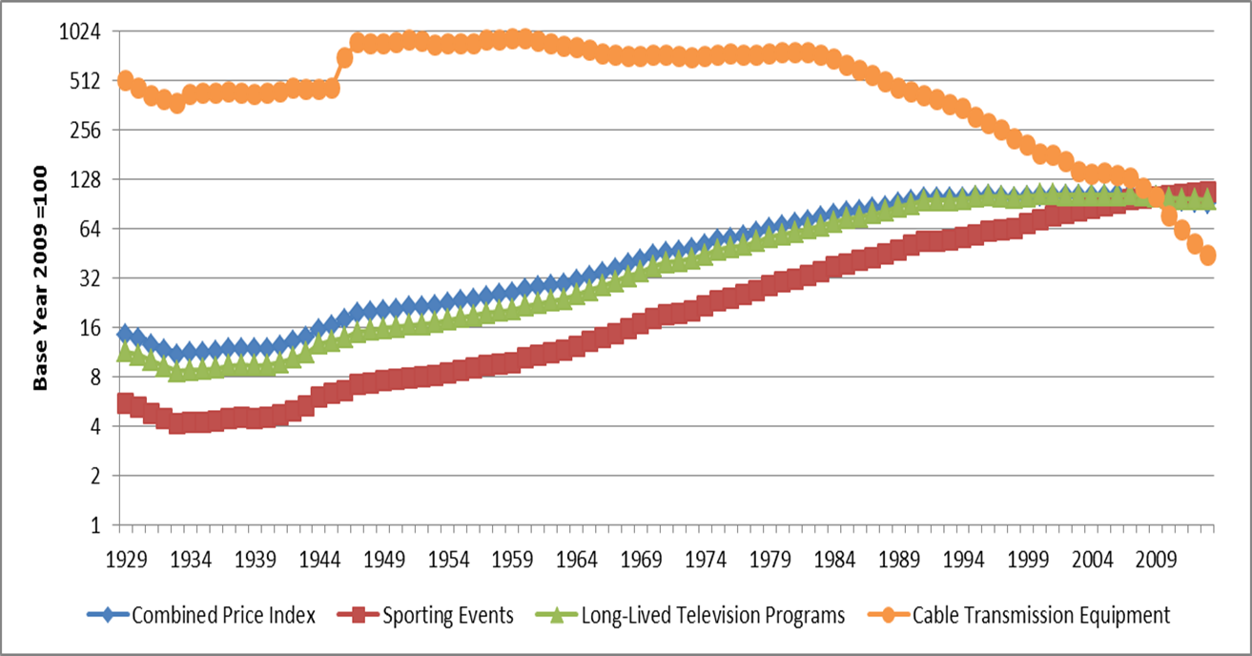
Prices for Cable and Other Non-Broadcast Television Or Radio
This category includes satellite cable, broadcast networks watched through a cable subscription, online video like YouTube and online audio like Pandora
  Unlike broadcast radio or television, none of these subcategories rely on the public airwaves.

Slide 22
Measuring Prices for Ad Viewership
As with all inputs, neither the price nor quantity of advertising viewership has any direct effect on final expenditures.
  Input price and quantities do change measured TFP.
We calculate viewership prices indirectly:
  First, we estimate a advertising viewership quantities
  We then divide nominal advertising revenue by our quantity index to get prices.
Our quantity indexes are based on a variety of sources.

Slide 23
Background on TFP Calculations
When calculating TFP, we added new output and new input for each industry.
  Media companies produce ‘free’ media and barter them for advertising viewership.
  The household sector produces advertising viewership and barters it for ‘free’ entertainment
  Companies produce advertising viewership and barter it for ‘free’ business information
We calculated industry-level TFP for each of the 63 business sector industries tracked by BEA and BLS in their joint production accounts.
  Our historical data is taken from Jorgenson, Ho, Samuels (2015)
  We do not calculate TFP for the government sector or the newly introduced household viewership sector.
  Our graphs split the 63 industries into two groups: media companies and all other industries.
  When calculating aggregate TFP, we weight each industry based on gross output.
We calculate the TFP impact for each media category separately.
  Results are similar if we calculate the joint impact of all advertising supported media.

Slide 24
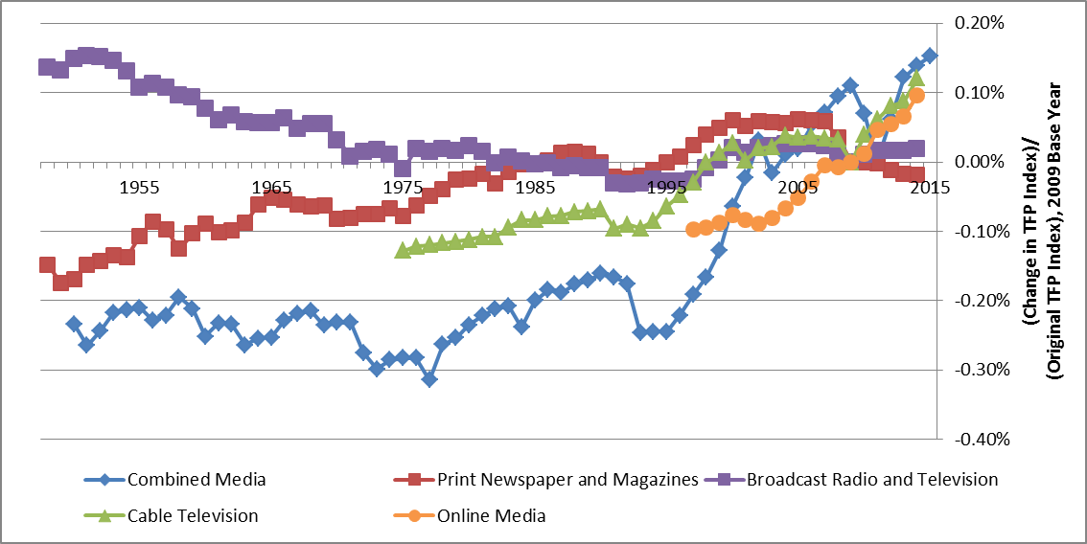
Change in Business Sector TFP from ‘Free’ Media
Consistent with previous research, measured TFP growth would be higher if ‘free’ online media was included in the I-O accounts.
  However, the increase in TFP growth is relatively small and not nearly enough to reverse the recent slowdown in productivity growth.
The graph shows aggregate TFP, but we’ve also calculated TFP by industry

Slide 25
Other Examples of Media Mismeasurement?
Access to the Internet by cell phone and broadband
Rapid rises in data usage on the order of Moore’s Law:
  U.S. cellular data traffic: 0.39 petabytes in 2010 to 4.06 petabytes in 2014 (CTIA)
  U.S. Internet data traffic: 36 exabytes in 2008 to 157 exabytes in in 2012 (Cisco)
Are BEA’s published NIPA’s capturing these changes?
  U.S. real PCE for cellular phone services rises from 5% per year from 2010 to 2014.
  U.S. real PCE for Internet access rises from 13% per year from 2008 to 2012.
Greenstein and McDevitt (2011a,b) take two different routes to measuring deflator for broadband from 2004 to 2009, show declines of about 2 % a year
Nevo et al (2015) show that heterogeneity in broadband demand is large and important.
Byrne and Corrado (2015) show that quality-adjusted prices for telecommunications equipment have fallen 10% per year since 1985.
The telecommunication sector is much larger than the online media industry alone
  Nominal PCE for cellular phone and Internet access rose from 0.1 percent of GDP in 1994 to to 1.2 percent in 2014.
  Because the telecommunications sector is larger, it has more potential to impact aggregate TFP growth.
However, new price indexes for telecommunications and other IT goods and services are not directly related to the conceptual question of how to measure online media.
  Research on hedonic computer prices started long before the Internet (Triplett 1989).
  This paper will focus on advertising-supported media and not attempt to solve every possible Silicon Valley puzzle.

Slide 26
An omission from our model:
URL: Ubiquity now, Revenues Later
In this section, we explore non-media Internet start-ups like Uber or Amazon which offer content below cost temporarily.
  These companies rely on positive network externalities.
Equity valuation:
  Google, Facebook, Yahoo!, LinkedIn and Twitter together had an equity value of $650 B in 2015, up from $50 B in 2005.
  U.S. Unicorns had $300 B in equity value in 2015 (CB Insights)
Private placement (these are the streams of investment money available for firm investments):
  Internet firms raised $85 B in private placements from 1999-2001, $75 B in private placements from 2013-2015 (S&P Capital IQ)
We analyze URL firms using the same methodology developed earlier for advertising-supported media

Slide 27
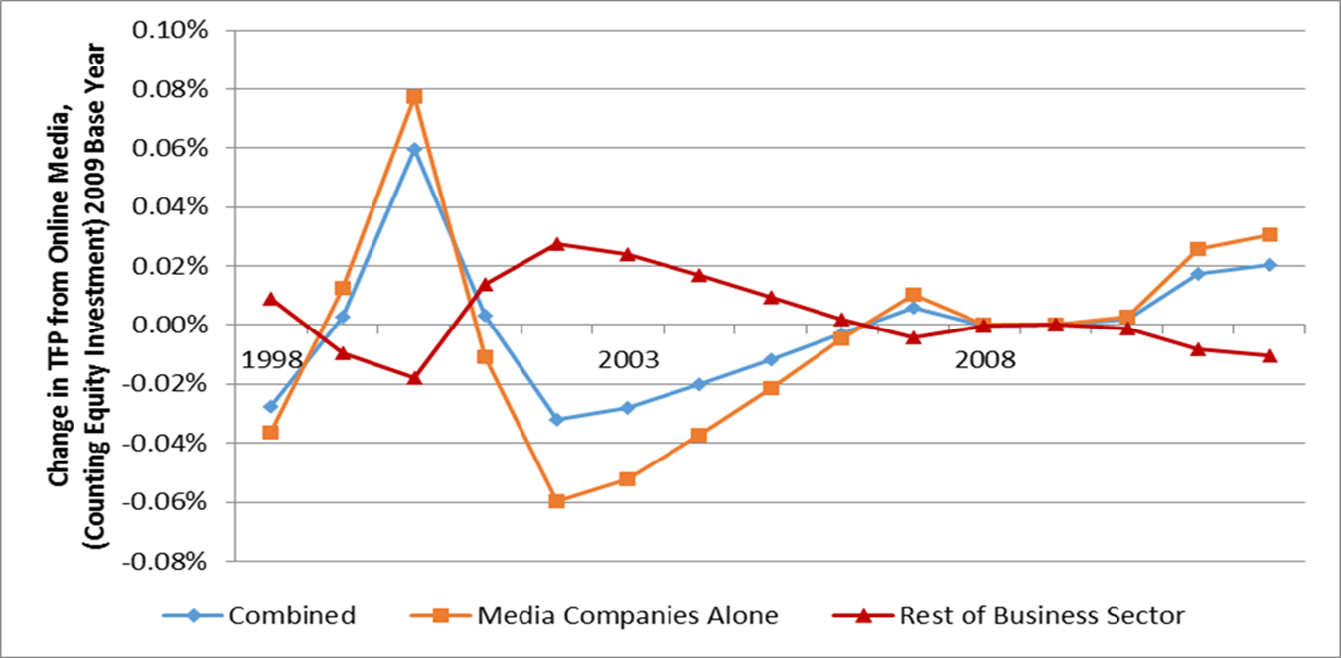
Change in Private Sector TFP with URL Adjustment
Adding the URL adjustment increases the quantity of output supplied by Internet companies, raising nominal and real output and thus TFP growth.
The recent burst of URL over the period 2013-15 is not in this graph, which ends in 2012, but the boost is smaller than from the 1999-2001 episode.

Slide 28
Conclusion
We recalculated GDP when ‘free’ media is included in final expenditures.
We find a small increase in recent GDP growth, but not enough to fix the recent stagnation.
  This GDP result is not inconsistent with papers finding huge consumer surplus from the Internet. (Brynjolfsson and Oh 2012, Varian 2011, Ito 2013, Aeppel 2015).
Before 1998, long-term GDP growth is unchanged.

