Slide 1
What Have We Learned about Incarceration and Race? Lessons from 30 years of Research Samuel L. Myers, Jr. University of Minnesota
LERA/ASSA Panel, San Francisco, CA January 4, 2016

Slide 2
Overview
Stylized Facts About Black Incarceration Rates, 1970s to Present
Catalogue of Explanations
The Dire Consequences
Implications for the Future

Slide 3
Stylized facts

Slide 4
Incarceration
USA: second highest incarceration rate in the world
Black incarceration rates 6-7 times that of whites
Incarceration rose from 200,000 in 1970s to more than 1.5 Million in 2010

Slide 5
Countries with the largest number of prisoners per 100,000 of the national population, as of June 2014
Note: Worldwide; As of June 25, 2014
Further information regarding this statistic can be found on page 8.
Source: ICPS; ID 262962

Slide 6
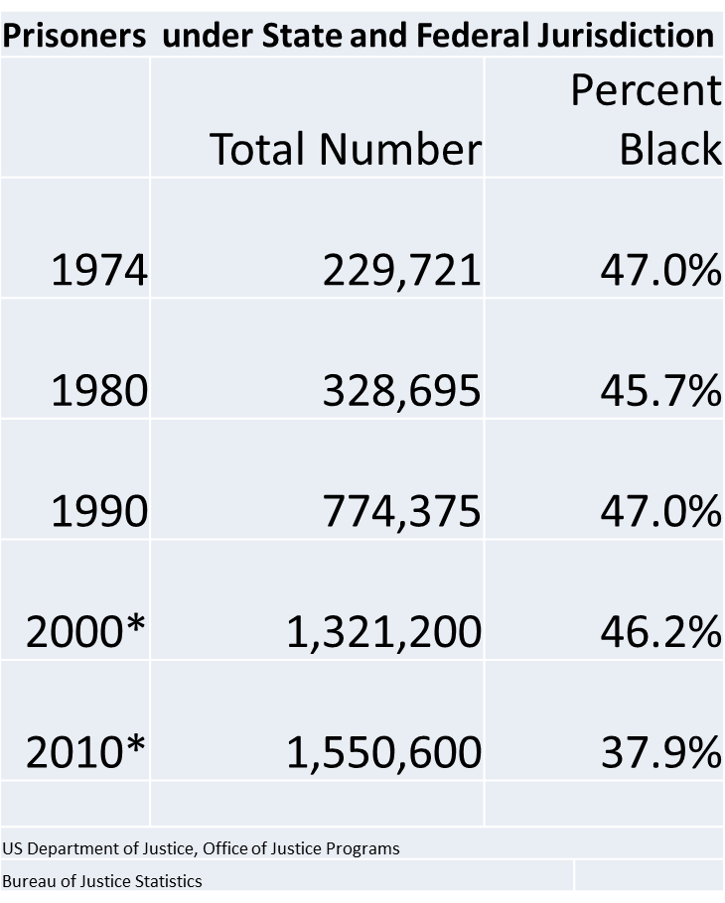

Slide 7
Sharp increases 1970s – 1990s; Rise in White incarcerations in 2000s

Slide 8
Catalogue of explanations

Slide 9
Social and Economic Explanations
Structural
Labor markets
Schools (suspensions as pipelines to prison)
Housing markets (segregated islands of isolation)
Behavioral
Drug use and drug sales
Theft and larceny
Thrill seeking
Anti-authoritarianism

Slide 10
Explanations
Structural
Behavioral
Prisons as labor market equilibrating devices
Superfluous labor: Prisons drain off unwanted workers
Labor shortages
Prisons release workers into labor markets
High unemployment produces high incentives to engage in criminal activities
High rates of criminal involvement produce high arrests rates and high incarceration rates

Slide 12
Explanations (cont.)
Structural
Behavioral
Discrimination in:
Traffic Stops
Arrests
Bail setting
Prosecution
Sentencing
Probation and Parole
Offender decisions that result in higher rates of:
Traffic stops
Arrests
Bail
Guilty Pleas
Longer sentences
Lower probabilities of probation or parole

Slide 14
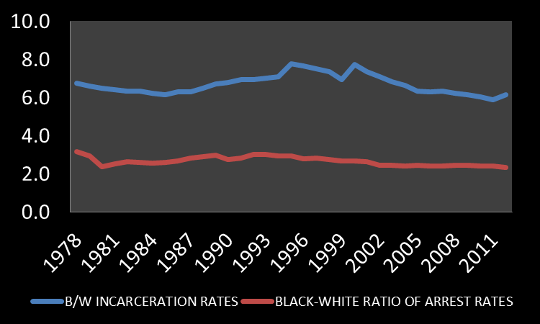
Disparity in Incarcerations Greater than the Disparity in Arrests

Slide 15
The (in)Efficiency of Racial Disparities in Incarceration

Slide 16
The Problem
Wide racial disparities in incarceration
Are these disparities “efficient” in the sense that they help to reduce crime?
Are these disparities the result of discrimination?

Slide 17
Sources of Potential Inefficiency in Racial Disparities in Incarceration
Family Instability Effects
Higher black incarceration rates lead to lower supplies of marriageable black males
Lower supplies of marriageable black males results in lower black marriage rates
Lower black marriage rates result in higher rates of female-headship
Higher female-headship rates associated with lower incomes, higher drop-out rates, higher crime rates
Absence of fathers associated with higher rates of criminality
Widening gaps in family incomes (Darity, et al. “Racial Earnings Disparities and Family Structure," Southern Economic Journal 65(1)(July 1998): 20–41)
Accumulation of Criminal Human Capital

Slide 18
Sources of Potential Efficiencies of Racial Disparities in Incarceration
Deterrent Effects
Lower crime rates among blacks who estimate that they will serve longer prison terms if convicted
Lower entry into crime overall by observation of lengthy prison sentences for minor crimes
Incapacitation Effects
Lower overall crime rates due to incarceration of career criminals

Slide 19
Case Study: Federal Prison Parole

Slide 20
The Context of the Debate
Sentencing reforms
Eliminate different punishments for same crimes
Reduce judicial discretion
Reduce racial disparities
Conservative support for sentencing reforms
Racial discrimination does not exist; need to reign in the discretion of “liberal” judges
More lengthy sentences for more “serious crimes” e.g. crack cocaine possession
Liberal support for sentencing reforms
Lower racial disparities
Increase “rationality” of punishment
Eliminate discretion of “racist” judges

Slide 21
Testing for discrimination in punishment

Slide 26
(in)Efficiency Effects of Discrimination in Punishment
Replace black Release on Parole rate with discrimination free-value
More blacks released on parole
But, positive coefficient on release on parole in black recidivism equation
Result, higher black recidivism rate at higher black release rates
By how much?
Note coefficient is small and statistically insignificant
Works out to about 1 out of 222 releases

Slide 27
Are racial disparities in incarceration due to racial disparities in drug arrests?

Slide 28
Effects of Drug Arrests on Incarceration Rates
Larger impacts of lagged white drug arrests on white incarceration rates than lagged black drug arrests on black incarceration rates

Slide 29
Effects of Drug Arrests on Incarceration Rates

Slide 30
The dire consequences

Slide 31
Consequences
States where felons cannot vote:
Alabama
Arizona
Delaware
Florida
Iowa
Kentucky
States where felons cannot vote:
Mississippi
Nevada
Tennessee
Virginia
Wyoming

Slide 32
Consequences
Reduced supply of marriageable males
Increases in female headed families
Lower incomes in families with head with conviction

Slide 33
Jobs Convicted Felons Cannot Hold
Texas
Minnesota
Work with children (childcare, education)
Elderly adults (home care)
Locksmith
Barbers
Electricians
Pharmacists
MORTGAGEORIGINATOR;
INSURANCE AGENT
NURSING HOMES AND HOME CARE
AUDIOLOGISTS
PHYSICAL THERAPISTS
DENTISTS,
VETERINARIANS,

Slide 34
Implications for the Future
Jobs for returning ex-offenders
Re-integration into communities
Subsidies for hiring ex-offenders
Family support
Entrepreneurship opportunities
Small business ownership
Skilled trades (e.g. electricians, plumbers, painters)
Rethinking licensing restrictions

Slide 35
Thank you!
myers006@umn.edu
www.hhh.umn.edu/centers/wilkins

